Slide 1
UPPER SIXTH ARTS
GEOGRAPHY
Quantitative Techniques 4: Plotting and Interpreting Graphical Tools
Plotting and Interpreting Graphical Tools
Notes:
Good morning, class, and welcome to our geography lesson. I am your geography teacher, Mr Kamdem. Today we are starting Quantitative Techniques 4: Plotting and Interpreting Graphical Tools.

Slide 2
CLASS INFO
Class, Chapter and Duration
Class | Upper Sixth Arts
Chapter | Module 8: Understanding and carrying out statistical techniques, topographic map analysis, fieldwork and project based learning
Duration | 2 periods (2 × 50 minutes)
Notes:
This lesson is for Upper Sixth Arts. It belongs to Module 8: Understanding and carrying out statistical techniques, topographic map analysis, fieldwork and project based learning. We shall need 2 periods to cover it.

Slide 3
IDENTIFICATION
Lesson Identification
Topic | Quantitative Techniques in Geography
Sub-topic | Graphical Techniques
Lesson | Quantitative Techniques 4: Plotting and Interpreting Graphical Tools
Notions / Concepts | Bar graph, compound bar, line graph, ogive, climograph, pie chart, triangular graph, scatter graph.
Syllabus focus | Construction and interpretation of bar graphs, line graphs, cumulative frequency curves (ogive), climographs, pie charts, triangular graphs and scatter graphs.
Competence | Learners are able to draw and interpret the main geographical graphs.
Notes:
Our topic is Quantitative Techniques in Geography, and the sub-topic is Graphical Techniques. The key notions we shall use today are: bar graph, compound bar, line graph, ogive, climograph, pie chart, triangular graph, scatter graph. At the end, you should be able to do this: learners are able to draw and interpret the main geographical graphs.

Slide 4

HOMEWORK CORRECTION
Correction of the Homework
Question (Quantitative Techniques 3: Basic Tools of Data Analysis):
Collect the daily maximum temperature for 7 days and calculate the mean and standard deviation.
Notes:
Before we start the new lesson, let us correct the homework I gave you at the end of Quantitative Techniques 3: Basic Tools of Data Analysis. The question was: Collect the daily maximum temperature for 7 days and calculate the mean and standard deviation. Take out your exercise books.

Slide 5
HOMEWORK CORRECTION
Correction: Possible Answer
Example: 34, 35, 33, 36, 35, 37, 35 °C. Mean = 245 ÷ 7 = 35 °C. Deviations² = 1, 0, 4, 1, 0, 4, 0 → sum 10; variance = 10 ÷ 7 = 1.43; SD = √1.43 ≈ 1.2 °C.
Notes:
Here is a good answer. Example: 34, 35, 33, 36, 35, 37, 35 °C. Mean = 245 ÷ 7 = 35 °C. Deviations² = 1, 0, 4, 1, 0, 4, 0 → sum 10; variance = 10 ÷ 7 = 1.43; SD = √1.43 ≈ 1.2 °C. Compare it with your own answer and correct your work in red.

Slide 6
LESSON PLAN
Lesson Plan
Correction of the homework
Objectives and recall
Real-life situation and action to take
Learning activities
Board summary
Evaluation, remediation and homework
Notes:
Here is the plan of our lesson today. First, we shall correct the homework. Then we shall look at the objectives and recall what you already know. After that, we shall study a situation from real life and the action to take, and do the learning activities. Finally, we shall copy the board summary, do the evaluation and the remediation, and I will give you the homework.

Slide 7
OBJECTIVES
Objectives
By the end of this lesson, you should be able to:
Choose the right graph for a data set.
Construct bar, line, pie and compound graphs.
Notes:
Take your time to copy this part; we will continue together.

Slide 8
OBJECTIVES
Objectives (continued)
Interpret ogives, triangular and scatter graphs.
Notes:
By the end of this lesson, you should be able to do three things. Number 1: choose the right graph for a data set. Number 2: construct bar, line, pie and compound graphs. Number 3: interpret ogives, triangular and scatter graphs.

Slide 9
PREVIOUS KNOWLEDGE
Previous Knowledge
Graphs show data visually.
A climate graph shows rain and temperature.
Notes:
Let us first remember what you already know. Graphs show data visually. A climate graph shows rain and temperature. Keep this in mind, because we shall build on it today.

Slide 10
REAL-LIFE SITUATION
Situation in Real Life
For a school exhibition, the class must present data on urban population, jobs by sector, travel times to school and the climate of Garoua with the best graphs.
Notes:
Listen carefully to this situation from real life. For a school exhibition, the class must present data on urban population, jobs by sector, travel times to school and the climate of Garoua with the best graphs. Think about it, because I am going to ask you some questions.

Slide 11
REAL-LIFE SITUATION
Situation: Question 1
What is the problem in the situation?
Notes:
Question 1: What is the problem in the situation? Think for a moment, then raise your hand to answer.

Slide 12
REAL-LIFE SITUATION
Answer
The class must choose and draw suitable graphs.
Notes:
Good. The class must choose and draw suitable graphs.

Slide 13
REAL-LIFE SITUATION
Situation: Question 2
Which graph suits jobs by sector (%)?
Notes:
Question 2: Which graph suits jobs by sector (%)? Think for a moment, then raise your hand to answer.

Slide 14
REAL-LIFE SITUATION
Answer
A pie chart (or triangular graph).
Notes:
Good. A pie chart (or triangular graph).

Slide 15
REAL-LIFE SITUATION
Situation: Question 3
Which graph shows the climate of Garoua?
Notes:
Question 3: Which graph shows the climate of Garoua? Think for a moment, then raise your hand to answer.

Slide 16
REAL-LIFE SITUATION
Possible Answer
A climograph.
Notes:
Good. A climograph.

Slide 17
ACTION TO TAKE
Action to Take
Draw neat graphs with a title, labelled axes and a key.
Notes:
From this situation, the action we are working towards in this lesson is the following: draw neat graphs with a title, labelled axes and a key.

Slide 18
JUSTIFICATION
Justification of the Lesson
This lesson helps us to present data clearly with graphs.
Notes:
Why is this lesson important for you? This lesson helps us to present data clearly with graphs.

Slide 19
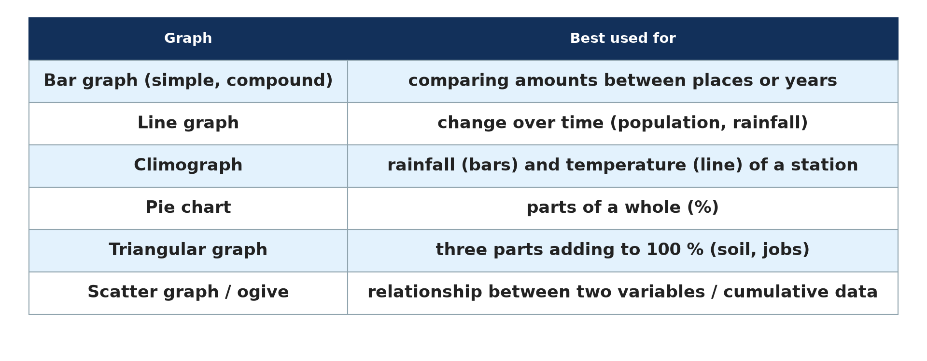
1. CHOICE OF GRAPH
Activity 1
Which graph for which data.
Notes:
Activity 1. Look carefully at this diagram: which graph for which data. Observe every detail before I ask the question.

Slide 20
1. CHOICE OF GRAPH
Activity 1: Question
Which graph would you use for change over time?
Notes:
Here is the question for Activity 1: Which graph would you use for change over time? Take one minute to think and write your answer in your rough notebook.

Slide 21
1. CHOICE OF GRAPH
Activity 1: Answer
A line graph.
Notes:
Let us check the answer together. A line graph.

Slide 22
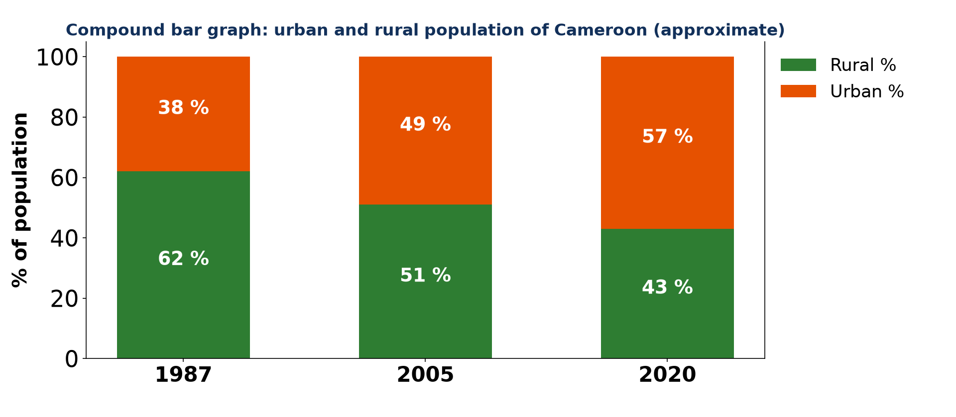
2. BAR GRAPHS
Activity 2
A compound bar graph (approximate).
Notes:
Activity 2. Look carefully at this diagram: a compound bar graph (approximate). Observe every detail before I ask the question.

Slide 23
2. BAR GRAPHS
Activity 2: Question
Describe the trend of urban population.
Notes:
Here is the question for Activity 2: Describe the trend of urban population. Take one minute to think and write your answer in your rough notebook.

Slide 24
2. BAR GRAPHS
Activity 2: Answer
It increased from 38 % in 1987 to 57 % in 2020.
Notes:
Let us check the answer together. It increased from 38 % in 1987 to 57 % in 2020.

Slide 25
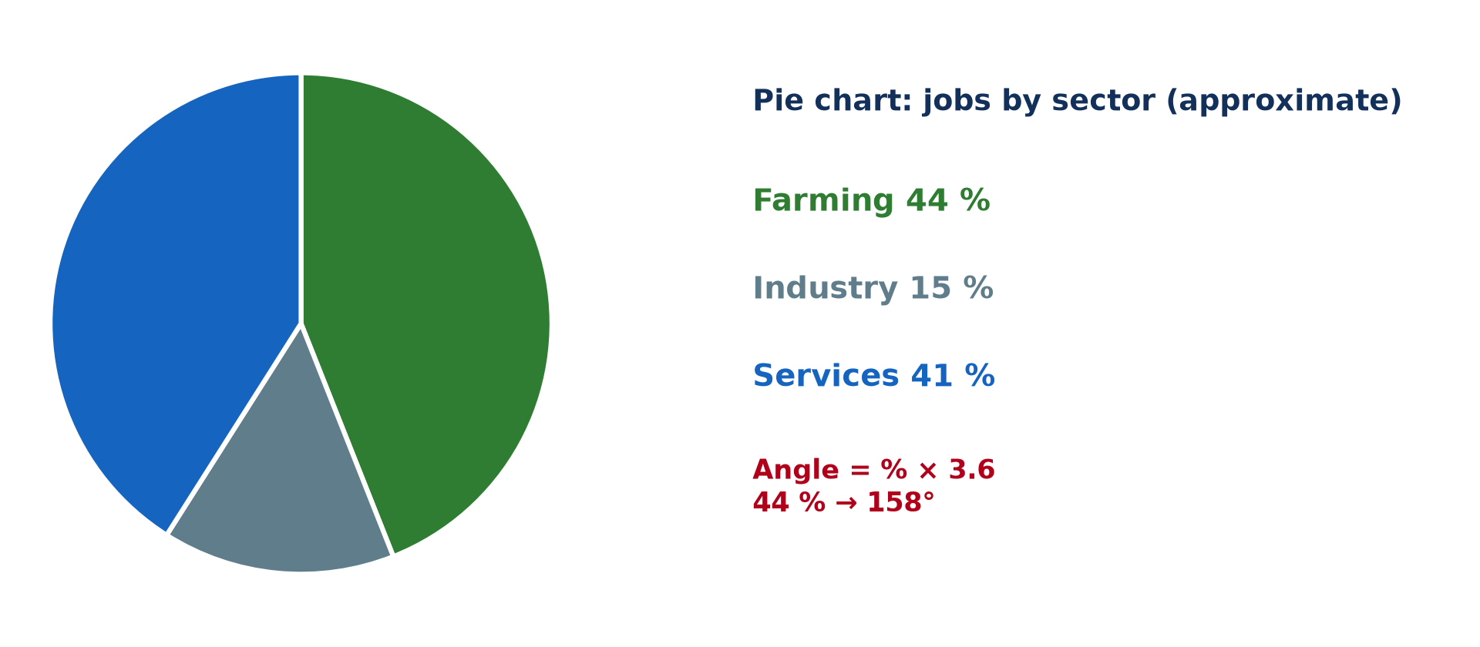
2. PIE CHARTS
Activity 3
A pie chart (approximate).
Notes:
Activity 3. Look carefully at this diagram: a pie chart (approximate). Observe every detail before I ask the question.

Slide 26
2. PIE CHARTS
Activity 3: Question
Calculate the angle for 15 %.
Notes:
Here is the question for Activity 3: Calculate the angle for 15 %. Take one minute to think and write your answer in your rough notebook.

Slide 27
2. PIE CHARTS
Activity 3: Answer
15 × 3.6 = 54°.
Notes:
Let us check the answer together. 15 × 3.6 = 54°.

Slide 28
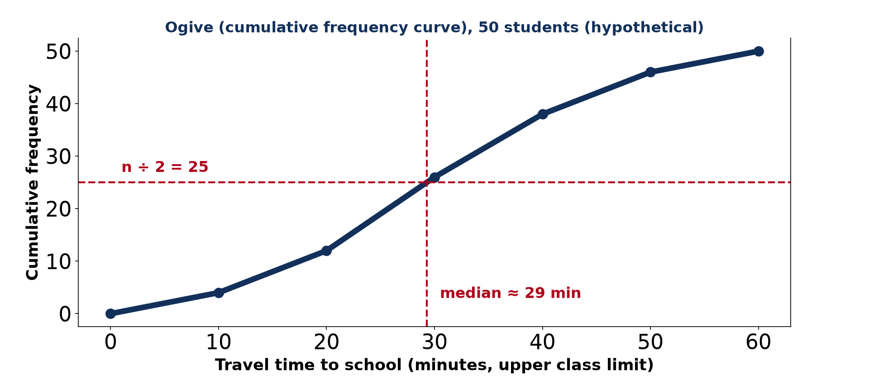
3. OGIVE
Activity 4
A cumulative frequency curve.
Notes:
Activity 4. Look carefully at this diagram: a cumulative frequency curve. Observe every detail before I ask the question.

Slide 29
3. OGIVE
Activity 4: Question
How is the median read from an ogive?
Notes:
Here is the question for Activity 4: How is the median read from an ogive? Take one minute to think and write your answer in your rough notebook.

Slide 30
3. OGIVE
Activity 4: Answer
Read across from n ÷ 2 to the curve, then down to the x-axis.
Notes:
Let us check the answer together. Read across from n ÷ 2 to the curve, then down to the x-axis.

Slide 31
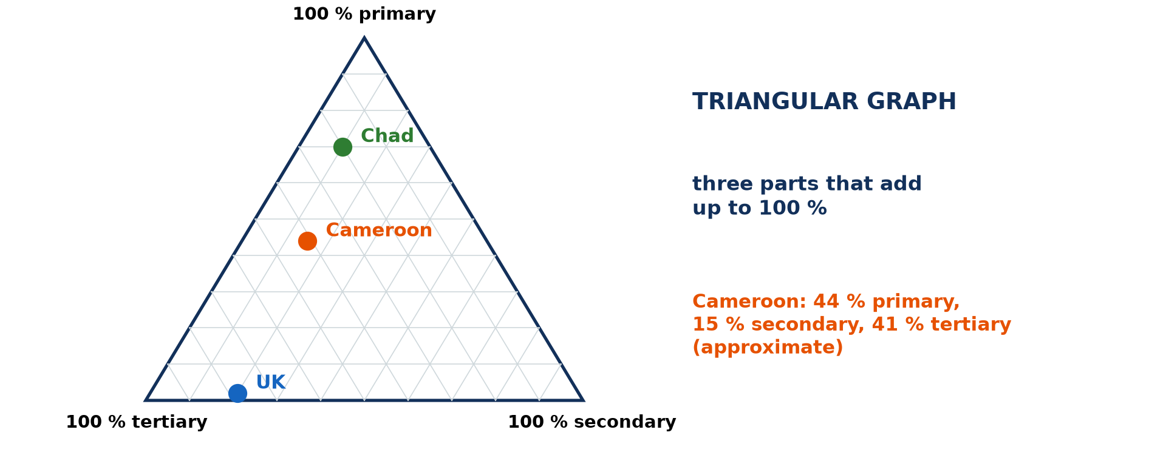
4. TRIANGULAR GRAPH
Activity 5
A triangular graph.
Notes:
Activity 5. Look carefully at this diagram: a triangular graph. Observe every detail before I ask the question.

Slide 32
4. TRIANGULAR GRAPH
Activity 5: Question
When is a triangular graph used?
Notes:
Here is the question for Activity 5: When is a triangular graph used? Take one minute to think and write your answer in your rough notebook.

Slide 33
4. TRIANGULAR GRAPH
Activity 5: Answer
For three parts that add up to 100 %, like employment sectors or soil texture.
Notes:
Let us check the answer together. For three parts that add up to 100 %, like employment sectors or soil texture.

Slide 34
BOARD SUMMARY
Board Summary
Topic: Quantitative Techniques in Geography
Sub-topic: Graphical Techniques
Quantitative Techniques 4: Plotting and Interpreting Graphical Tools
Notes:
Now we are going to copy the board summary. Write the title and the headings neatly in your notebooks. I will give you enough time for each slide, so do not rush.

Slide 35
BOARD SUMMARY
1. Choice of Graph
The graph is chosen according to the data:
Line graph and climograph: A line graph shows change over time, such as population growth. A climograph combines temperature (line) and rainfall (bars) for a station.
Notes:
Let us copy Choice of Graph. The graph is chosen according to the data. On this slide we have Line graph and climograph. Write each point on a new line, with the key term first, and explain it in your own words when we revise. When you finish, we go to the next slide.

Slide 36
BOARD SUMMARY
1. Choice of Graph (continued)
Bar graphs: Simple bars compare separate items, and compound bars show the parts of each total. Bars must have equal widths and start from zero.
Notes:
We continue with Choice of Graph. On this slide we have Bar graphs. Write each point on a new line, with the key term first, and explain it in your own words when we revise.

Slide 37
BOARD SUMMARY
1. Choice of Graph
Illustration: which graph for which data
Notes:
Now draw this illustration in your notebook: which graph for which data. Give it a title and label it clearly.

Slide 38
BOARD SUMMARY
2. Pie Charts and Ogives
These graphs show proportions and distributions:
Pie chart: Each value is converted into an angle (% × 3.6). It shows the parts of a whole, such as jobs by sector.
Notes:
Let us copy Pie Charts and Ogives. These graphs show proportions and distributions. On this slide we have Pie chart. Write each point on a new line, with the key term first, and explain it in your own words when we revise. When you finish, we go to the next slide.

Slide 39
BOARD SUMMARY
2. Pie Charts and Ogives (continued)
Ogive (cumulative frequency curve): Cumulative frequencies are plotted against the upper class limits and joined smoothly. The median is read at n ÷ 2 and the quartiles at n ÷ 4 and 3n ÷ 4.
Notes:
We continue with Pie Charts and Ogives. On this slide we have Ogive (cumulative frequency curve). Write each point on a new line, with the key term first, and explain it in your own words when we revise.

Slide 40
BOARD SUMMARY
2. Pie Charts and Ogives
Illustration: a pie chart (approximate)
Notes:
Now draw this illustration in your notebook: a pie chart (approximate). Give it a title and label it clearly.

Slide 41
BOARD SUMMARY
3. Triangular and Scatter Graphs
These graphs show three parts and relationships:
Triangular graph: It shows three parts that add up to 100 %, such as employment sectors or soil texture. Each point is read along the three axes.
Notes:
Let us copy Triangular and Scatter Graphs. These graphs show three parts and relationships. On this slide we have Triangular graph. Write each point on a new line, with the key term first, and explain it in your own words when we revise. When you finish, we go to the next slide.

Slide 42
BOARD SUMMARY
3. Triangular and Scatter Graphs (continued)
Scatter graph: It plots one variable against another to show a relationship. A best-fit line shows whether the correlation is positive or negative.
Notes:
We continue with Triangular and Scatter Graphs. On this slide we have Scatter graph. Write each point on a new line, with the key term first, and explain it in your own words when we revise.

Slide 43
BOARD SUMMARY
3. Triangular and Scatter Graphs
Illustration: a triangular graph
Notes:
Now draw this illustration in your notebook: a triangular graph. Give it a title and label it clearly.

Slide 44
FORMATIVE EVALUATION
Evaluation 1
Give four elements every graph must have.
Notes:
Now let us check what you have understood. Question 1: Give four elements every graph must have. Answer in your exercise book.

Slide 45
FORMATIVE EVALUATION
Expected Answer
Title, labelled axes, units and key.
Notes:
The expected answer is: title, labelled axes, units and key. If you got it right, well done.

Slide 46
FORMATIVE EVALUATION
Evaluation 2
Farming 60 %, industry 10 %, services 30 %: give the pie angles.
Notes:
Now let us check what you have understood. Question 2: Farming 60 %, industry 10 %, services 30 %: give the pie angles. Answer in your exercise book.

Slide 47
FORMATIVE EVALUATION
Expected Answer
216°, 36°, 108°.
Notes:
The expected answer is: 216°, 36°, 108°. If you got it right, well done.

Slide 48
REMEDIATION
Remediation
Fill in the blanks:
A cumulative frequency curve is an ______.
Pie angle = % × ______.
Correlation is shown by a ______ graph.
Notes:
For those who need more practice, fill in the blanks in your exercise book. The answers are: number 1, ogive; number 2, ; number 3, 6; number 3, scatter.

Slide 49
HOMEWORK
Homework
Draw a climograph of your town using data from the nearest weather station.
Notes:
For your homework: Draw a climograph of your town using data from the nearest weather station. We shall correct it at the beginning of our next lesson.

Slide 50
NEXT LESSON
Next Lesson
Our next lesson will be on:
Field Work 1: Getting Geographical Coordinates
Notes:
Our next lesson will be on Field Work 1: Getting Geographical Coordinates. Thank you for your attention, and see you next time.

Slide 51
BILINGUAL GAME
Bilingual Game (Jeu Bilingue)
English | Français
Graph | Le graphique
Bar graph | L'histogramme
Pie chart | Le diagramme circulaire
Axis | L'axe
Scale | L'échelle
Trend | La tendance
Notes:
Let us play the bilingual game. I say a word in English, and you give me the French word. Then we do the reverse.

Slide 52
LOGBOOK
Official Logbook (1/2)
Module / Topic | Quantitative Techniques in Geography
Lesson Title | Quantitative Techniques 4: Plotting and Interpreting Graphical Tools
Expected Learning Outcomes | Choose the right graph for a data set. Construct bar, line, pie and compound graphs. Interpret ogives, triangular and scatter graphs.
Competence | Learners are able to draw and interpret the main geographical graphs.
Notes:
I record this information in the official logbook of the class after the lesson.

Slide 53
LOGBOOK
Official Logbook (2/2)
Matter Taught | Choice of Graph; Pie Charts and Ogives; Triangular and Scatter Graphs.
Evaluation | Formative evaluation and remediation exercise.
Homework | Draw a climograph of your town using data from the nearest weather station.
Enrolment / Present / Absent | ____ / ____ / ____
Achievement | To be completed after the lesson.
Notes:
I complete the second page of the logbook: the matter taught, the evaluation, the homework and the attendance.

Slide 54
TEACHER'S NOTE
Teacher's Note
Timing: Homework correction, plan, objectives 8 min | Recall, situation, action 10 min | 5 activities 30 min | Board summary (copying) 30 min | Evaluation, remediation 10 min | Homework, next lesson 5 min | Logbook 7 min
Without the projector (Activity 1): match data and graphs.
Without the projector (Activity 2): read the bars.
Without the projector (Activity 3): calculate angles.
Without the projector (Activity 4): find the median.
Without the projector (Activity 5): plot a point.
Notes:
This slide is for me, the teacher: it gives the timing of the lesson and what to do if the projector is not available.

Slide 55
REFERENCES
References
National Geography Syllabus, MINESEC/IGE/IP-SS, 2019 — Module 8 (Practical Geography).
Diagrams and animations: drawn for this lesson (Geography Department).
Notes:
These are the references and picture credits used to prepare this lesson.

